Slide 1

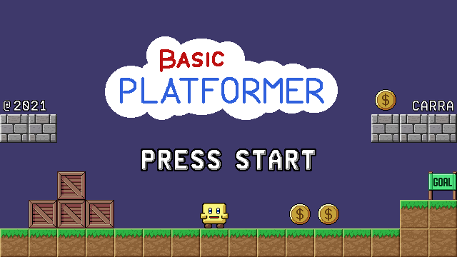
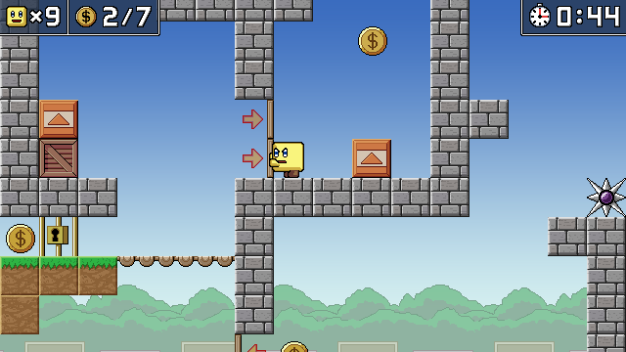
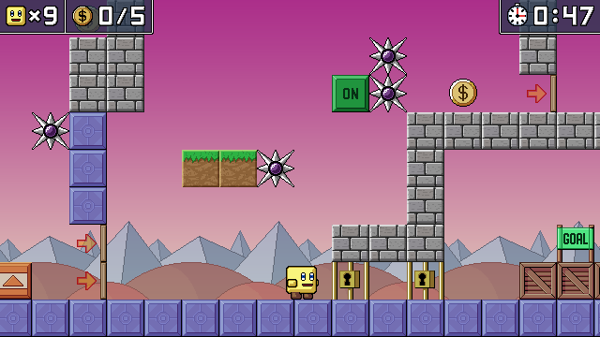
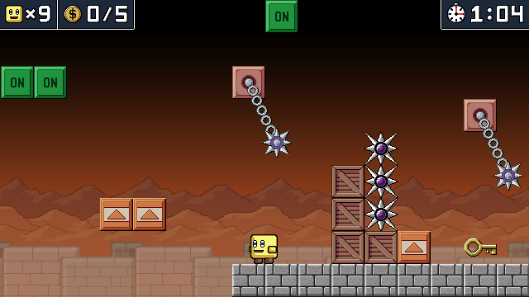

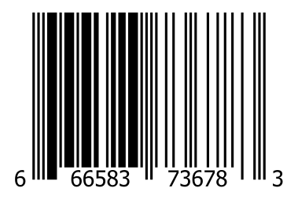
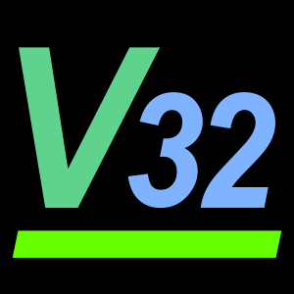
Yeah, it’s basic. But, basic does not mean easy!
If you want to beat this game, you will have to master every obstacle and their combinations. When you learn everything, you will have to do it fast since you go against the timer too!
This game has been designed with only a few elements on purpose. Its 3 worlds with 10 levels each will progressively introduce you to new elements and more complex mechanics.
In addition to making the game interesting to play, effort has also been placed on making the source code clean and with a clear structure so that it can be taken as an example.
This game is free and open source!
Get the game binaries and source code online.
CONTAINS ONLY INSTRUCTIONS
IN ENGLISH
Only for use with Vircon32 consoles.
Not compatible with other systems.
This seal is your guarantee that this product’s quality has been ensured by the Vircon32 community.
GAME SUITABLE FOR ALL AGES

